Slide 1
TOPICS
.Set Operators
.Common Table Expressions
.PIVOT operator
.

Slide 2
SET OPERATORS
They are used to combine multiple result sets from the input queries. They include:
UNION: Combines the result of two or more queries into a single result set
INTERSECTION: Returns the intersection of the result sets of two or more queries. i.e what is common between the result sets
EXCEPT: Find the difference between the two result sets of two input queries.

Slide 3
UNION
syntax:
query_1
UNION
query_2
Requirements for using the UNION operator:
1) The number and order of columns must be the same in both queries
2) The data types of the corresponding columns must be the same or compatible.

Slide 4
The UNION operator removes all duplicate rows from the result set. However, we can use UNION ALL to include duplicate rows in the final result set.
Syntax:
query_1
UNION ALL
query_2
When compared to the JOIN operator(eg. LEFT JOIN, INNER JOIN), UNION differs in that it combines rows from two result sets whereas JION combines columns from two result sets.

Slide 5
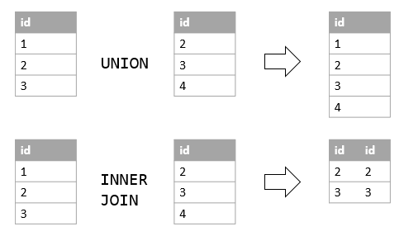
Difference between UNION and JION operator.

Slide 6
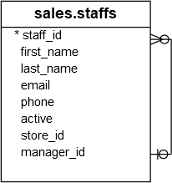
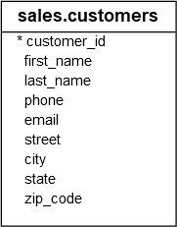
Sample tables.

Slide 7
Example. Using join operator based on the sample tables.
SELECT
first_name,
last_name
FROM
sales.staffs
UNION
SELECT
first_name,
last_name
FROM
sales.customers;

Slide 8
INTERSECT
Combines result sets of two or more queries and returns distinct rows that are output by both queries. i.e rows that appear in both inputs.
Syntax:
query_1
INTERSECT
query_2
Rules:
1) Both queries must have the same number and order of columns.
2) The data type of the corresponding columns must be the same or compatible

Slide 9
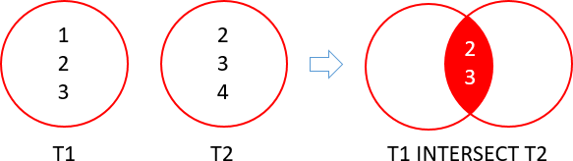
Illustration on INTERSECT

Slide 10
Example
SELECT
city
FROM
sales.customers
INTERSECT
SELECT
city
FROM
sales.stores
ORDER BY
city;

Slide 11
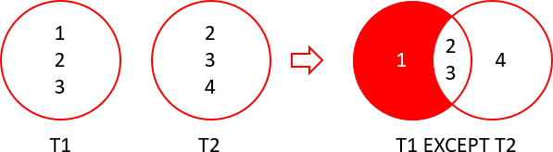
EXCEPT
It subtracts the result set of a query from another result set of another query i.e it returns the distinct rows from the first query that are not output by the second query.

Slide 12
Syntax:
query_1
EXCEPT
query_2
Rules:
1) Both queries must have the same number and order of columns.
2) The data type of the corresponding columns must be the same or compatible

Slide 13
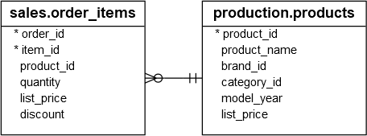
SELECT
product_id
FROM
production.products
EXCEPT
SELECT
product_id
FROM
sales.order_items;

Slide 14
CTE
Common Table Expressions

Slide 15
Common Table Expressions allow one to define a temporary named result set that is available temporarily in the execution scope of a statement such as SELECT, INSERT, UPDATE, DELETE or MERGE
Syntax:
WITH expression_name[(column_name [,...])]
AS
(CTE_definition)
SQL_statement;

Slide 16
We use the expression_name to later refer to the CTE when using it.
The number of comma separated columns must be the same as the number of columns defined in the CTE_definition.
Within the CTE_definition, define a SELECT statement whose result set populates the table expression.
You can finally refer to the CTE in a query i.e SELECT, INSERT...

Slide 17
Example:
WITH cte_sales_amounts (staff, sales, year) AS (
SELECT
first_name + ' ' + last_name,
SUM(quantity * list_price * (1 - discount)),
YEAR(order_date)
FROM
sales.orders o
INNER JOIN sales.order_items i ON i.order_id = o.order_id
NNER JOIN sales.staffs s ON s.staff_id = o.staff_id
GROUP BY
first_name + ' ' + last_name,
year(order_date)
)
SELECT
staff,
sales
FROM
cte_sales_amounts
WHERE
year = 2018;

Slide 18
We can omit the comma separated columns when defining a CTE. Works fine. Example:
WITH cte_sales AS (
SELECT
staff_id,
COUNT(*) order_count
FROM
sales.orders
WHERE
YEAR(order_date) = 2018
GROUP BY
staff_id
)
SELECT
AVG(order_count) average_orders_by_staff
FROM
cte_sales;

Slide 19
To use multiple CTE in a single query, use this syntax:
WITH first_CTE[(column_name [,...])]
AS
(CTE_definition)
), second_CTE[(column_name [,...])]
AS
(CTE_definition)
)
SQL_statement;

Slide 20
PIVOT OPERATOR

Slide 21
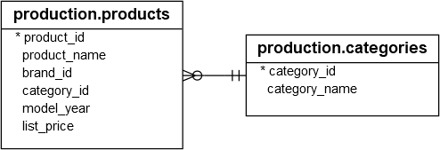
The PIVOT operator is used to convert rows to columns.
You follow these steps to make a query a PIVOT table:
Select a base dataset for pivoting.
Create a temporary result by using a derived table or a CTE.
Apply the PIVOT operator.
Example: We have two tables:

Slide 22
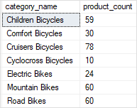
To find the number of products for each product category, we could do:
SELECT
category_name,
COUNT(product_id) product_count
FROM
production.products p
INNER JOIN production.categories c
ON c.category_id = p.category_id
GROUP BY
category_name;
We want to pivot and have this:

Slide 23
Syntax:
SELECT
<columns>
FROM
(
<derived_table>
) AS D
PIVOT
(
<aggregate_function>(<aggregate_column>)
FOR <spreading_element> IN (<target_columns>)
)

Slide 24
SELECT * FROM
(
SELECT
category_name,
product_id
FROM
production.products p
INNER JOIN production.categories c
ON c.category_id = p.category_id
) t
PIVOT(
COUNT(product_id)
FOR category_name IN (
[Children Bicycles],
[Comfort Bicycles],
[Cruisers Bicycles],
[Cyclocross Bicycles],
[Electric Bikes],
[Mountain Bikes],
[Road Bikes])
) AS pivot_table;

Slide 25
DYNAMIC PIVOT TABLES
In the previous example, if we were to add a new category name to production.categories, there would be need to rewrite our query.
As a way around this problem, we dont pass a fixed list of category names to the PIVOT operator, we construct the category name list and pass it to an SQL statement, and then execute this statement dynamically.

Slide 26
DECLARE
@columns NVARCHAR(MAX) = '',
@sql NVARCHAR(MAX) = '';
-- select the category names
SELECT
@columns+=QUOTENAME(category_name) + ','
FROM
production.categories
ORDER BY
category_name;
-- remove the last comma
SET @columns = LEFT(@columns, LEN(@columns) - 1);
-- construct dynamic SQL
SET @sql ='
SELECT * FROM
(
SELECT
category_name,
model_year,
product_id
FROM
production.products p
INNER JOIN production.categories c
ON c.category_id = p.category_id
) t
PIVOT(
COUNT(product_id)
FOR category_name IN ('+ @columns +')
) AS pivot_table;';
-- execute the dynamic SQL
EXECUTE sp_executesql @sql;

